Slide 1
Digital Forensics Web Browser and Email Forensics
Dr. Tran The Son
Vietnam – Korea University

Slide 2
Content
Web Browser Forensics
Google Chrome Browser Forensics
Mozilla Firefox Browser Forensics
Other Browser Forensics tools

Slide 3
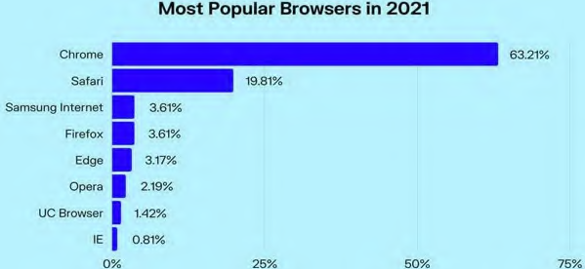
Web Browsers

Slide 4
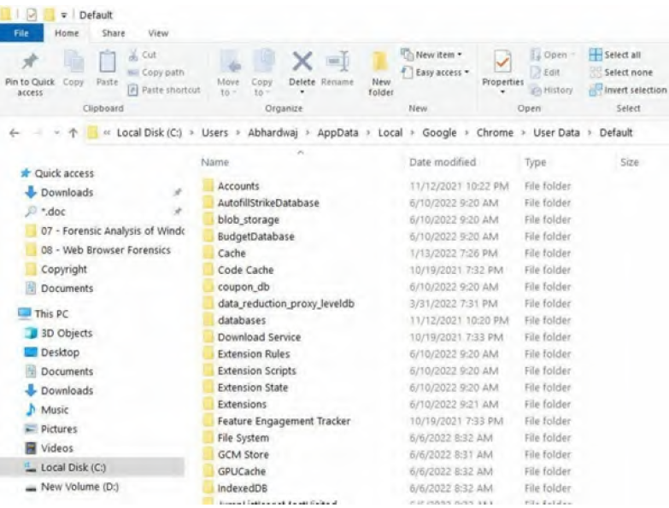
Google chrome browser forensics
C:\Users\<UserName>\AppData\Local\Google\Chrome\UserData\Default

Slide 5
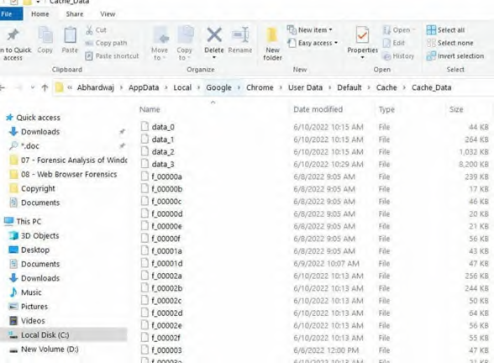
Google chrome browser forensics
Bookmarks (aka Favorite)
Cache
Users\<UserName>\AppData\Local\Google\Chrome\UserData\default\Cache.

Slide 6
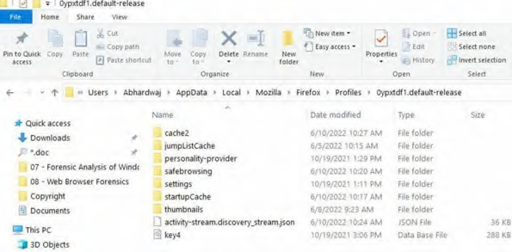
Mozilla Firefox Browser Forensics
Firefox does not use the Windows registry in the same manner that Internet Explorer does; instead, Firefox maintains its Web history, download history, and bookmarks in the places.sqlite database file.
%APPDATA%\Mozilla\Firefox\Profiles

Slide 7
Mozilla Firefox Browser Forensics
places.sqlite
Web history, download history, and bookmarks
Cookies.sqlite
Stores cookies left by previously visited websites formhistory.sqlite
Key4.db and logins.json:
permissions.sqlite
search.json.mozlz4
prefs.js
addons.json
Extension-data [Folder]

Slide 8
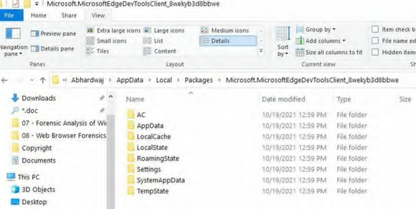
Microsoft Edge browser forensics
Users\UserName\AppData\Local\Packages\ Microsoft.MicrosoftEdgexxxx\
AC\MicrosoftEdge\UserDefault\DataStor
the Edge databases: Spartan.edb; WebCacheV01.dat

Slide 9
Other Web browser investigation tools
WebCacheImageInfo
https://www.nirsoft.net/utils/
ImageCacheViewer
https://www.nirsoft.net/utils/
Web Historian

Slide 10
How about Coc Coc Browser?

Slide 11
Email forensics

Slide 12
E-mail communication steps
E-mail protocols
Examine e-mail headers
Determine sender’s geolocation and time zone

Slide 13
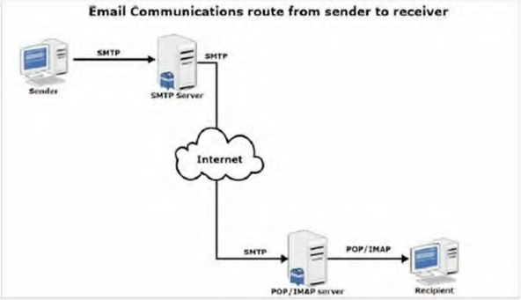

Slide 14
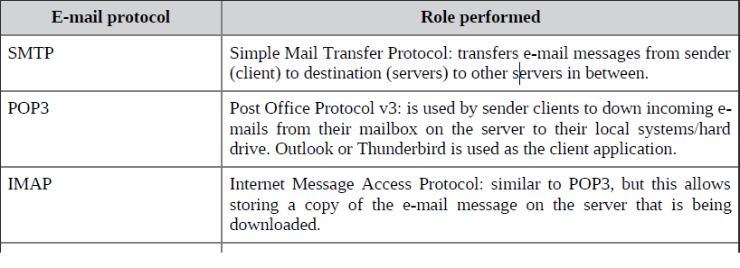

Email Protocols

Slide 15
Multipurpose Internet Mail Extension (MIME)
Limitations of Simple Mail Transfer Protocol (SMTP):
SMTP has a very simple structure
Its simplicity however comes with a price as it only sends messages in NVT 7-bit ASCII format.
It cannot be used for languages that do not support 7-bit ASCII format such as French, German, Russian, Chinese and Japanese, etc. so it cannot be transmitted using SMTP. So, in order to make SMTP more broad, we use MIME.
It cannot be used to send binary files or video or audio data.
MIME transforms non-ASCII data at the sender side to NVT 7-bit data and delivers it to the client SMTP

Slide 16
Examine e-mail headers
An e-mail header stores a wealth of forensically useful information about an e-mail under investigation, such as
the path it took over the internet to arrive, stop points/delays made during email delivery,
the IP address of the machine that sent this e-mail, in addition to the client (for example, e-mail program) who sent this e-mail and
the type of OS used (in some cases).
….

Slide 17
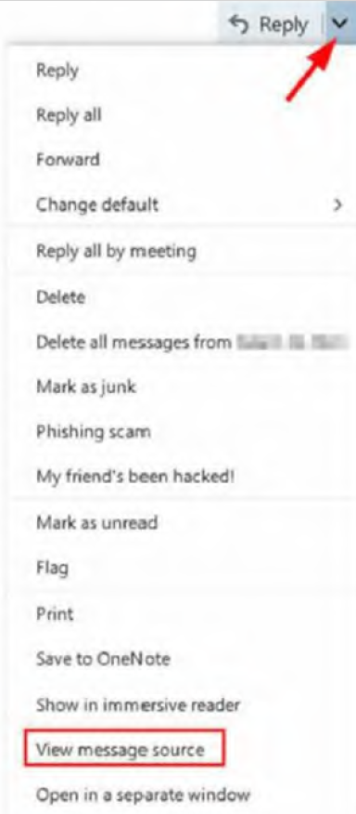
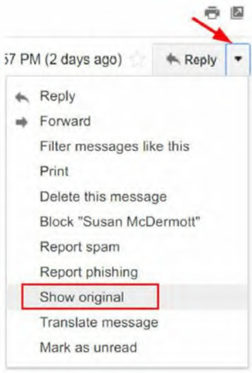
Examine e-mail headers

Slide 18
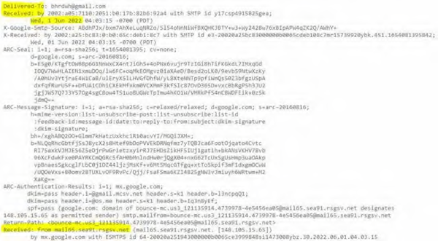

Analyzing e-mail headers
When an e-mail travels through the internet, each mail server the e-mail passes through will add a piece of information to the header.

Slide 19
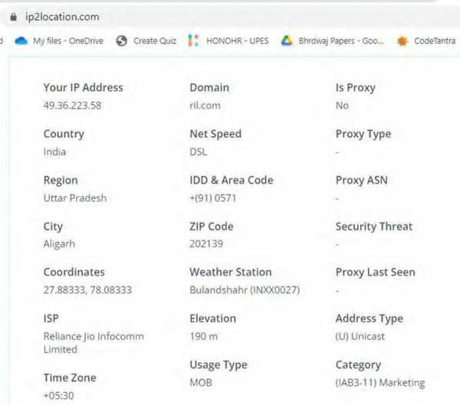
the sender’s geolocation and time zone

